Slide 1

Anemonefish POA Multiome Updates
Gabriel Graham

Slide 2
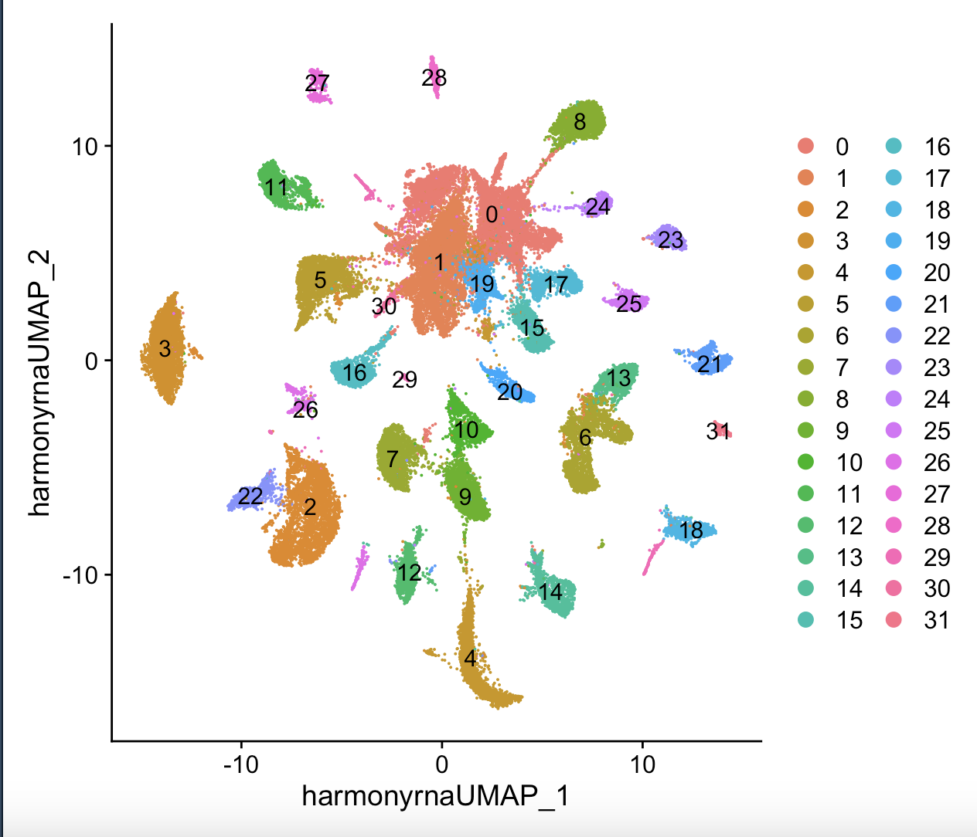
For Reference Here is Our UMAP
Notes:
Lynnas new clustering, 31 clusters

Slide 3
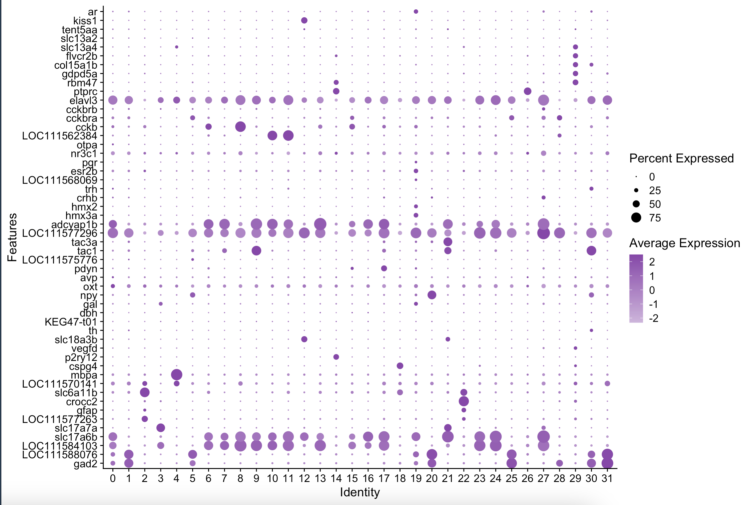
Here Are Our Marker Genes

Slide 4
Interesting Cell Types
We will see these interesting clusters again later
Cluster 19 – Mixed GABA+ and GLUT+ markers (interesting), expresses androgen receptor (ar), POA markers (hmx2, hmx3a), and estrogen receptor (esr2b). This is very obviously a POA cluster. Weakly cckb+
Cluster 3 – GLUT+, gal+, probably POA
Cluster 12- GLUT+, ach+ (slc18a3b), kiss1+
Cluster 15 – GABA+, cckb+ and cckbra+.
Notes:
The mix of gaba and glut markers in 19 is super interesting to me. Cluster 15 may be a cluster to avoid

Slide 5
The CCK System
There are a lot of CCK Clusters
ccka+ (LOC111562384)
Clusters 10, 11, weakly 0, 28
cckb+
Clusters 6 (Dm), 8, 15, weakly 2 (RG), 13 and 19
cckbra+
Cluters 5, 13, 15, 25, 27, 28, weakly 0, 1, 17, 31
cckbrb+
Cluster 27 weakly
Notes:
Only one cluster expresses cckbrb so I hope we are right that it is predominantly in the pituitary

Slide 6
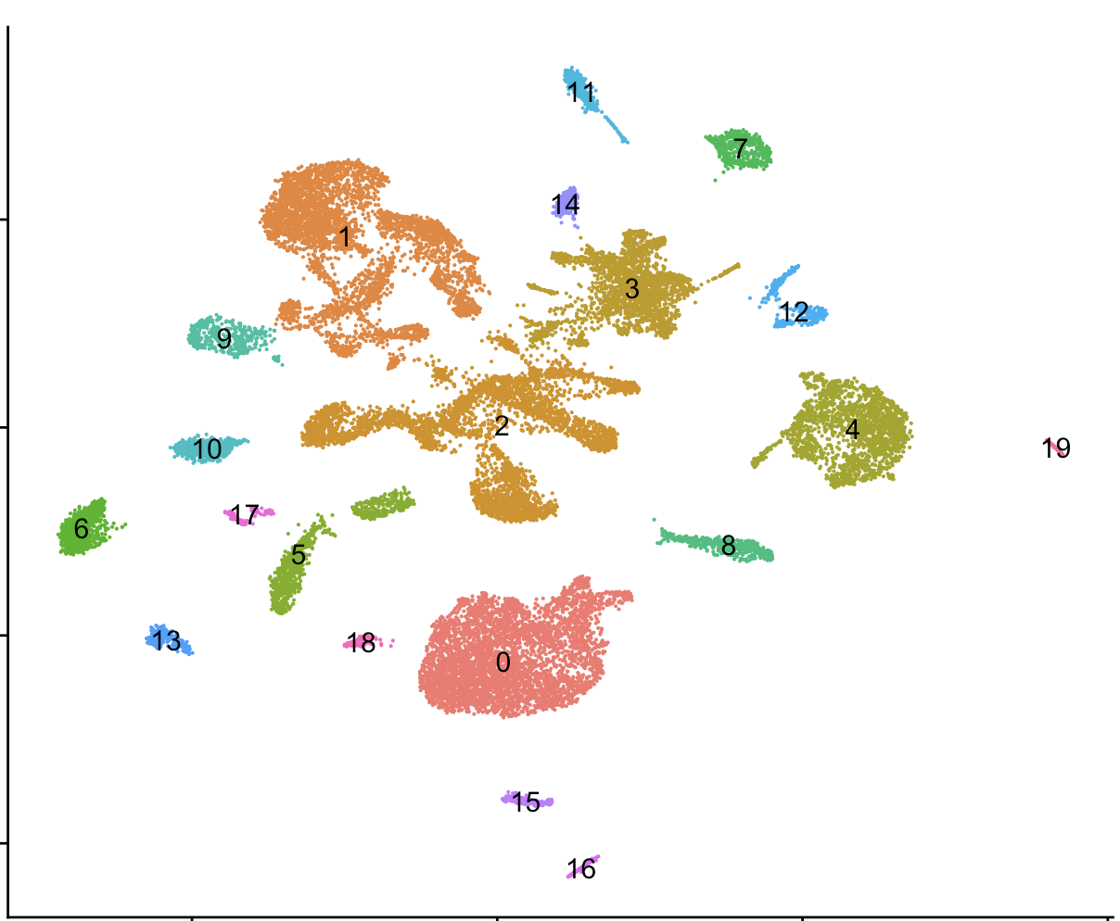
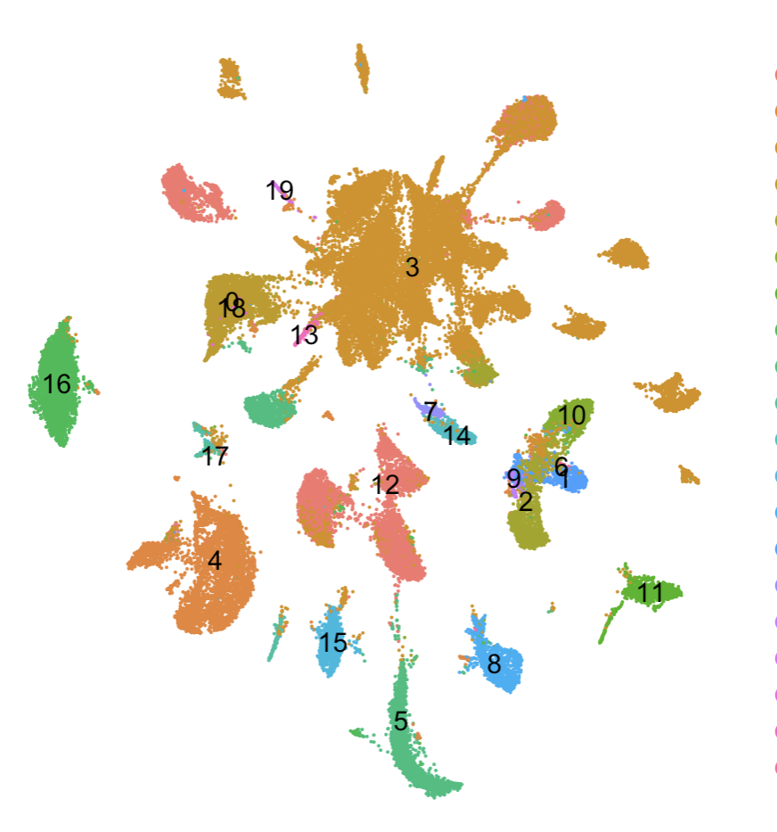
With the Old Labels – 3 = POA / POA Adjacent
Current Object Current Labels
Old Object Old Labels
Current Object Old Labels
Notes:
Here, I use the label transfer function from Seurat, though I still think its like playing a game of telephone with the cichlid data. I’d like to directly map my data to the cichlid daat

Slide 7
Putative IDs – A mess
Cluster | Putative Id
0 | POA_1
1 | POA_2
2 | Radial Glia
3 | gal+ GLUT
4 | Oligo
5 | npy+ cckbra+ GABA
6 | Dm
7 | tac1+ GLUT_1
8 | cckb+ GLUT_1 (Potentially POA)
9 | tac1+ GLUT_2
10 | ccka+ GLUT_1
11 | ccka+ GLUT_2
12 | ach+ kiss1+ GLUT
13 | Di-G
14 | Microglia
15 | pdyn+ GLUT (Potentially POA but also maps to 2a)
Cluster | Putative Id
16 | GLUT_1
17 | POA_3
18 | OPC
19 | POA_4
20 | npy+ GABA (Potentially Interneuron)
21 | ach+ GLUT (Potentially POA)
22 | Ependymal
23 | POA_5 (Potentially PVN)
24 | GLUT_2
25 | GABA_1 (Potentially POA)
26 | Leuko
27 | POA_6 (Also potentially PVN)
28 | ccka+ cckbra+ GABA (Potentially POA)
29 | Fibroblasts
30 | Olfactory Bulb
31 | GABA_2 (Potentially POA)
Notes:
7 9 and 10 align with 12 in previous object, what is it? This is all a mess again, I want the cichlid data

Slide 8
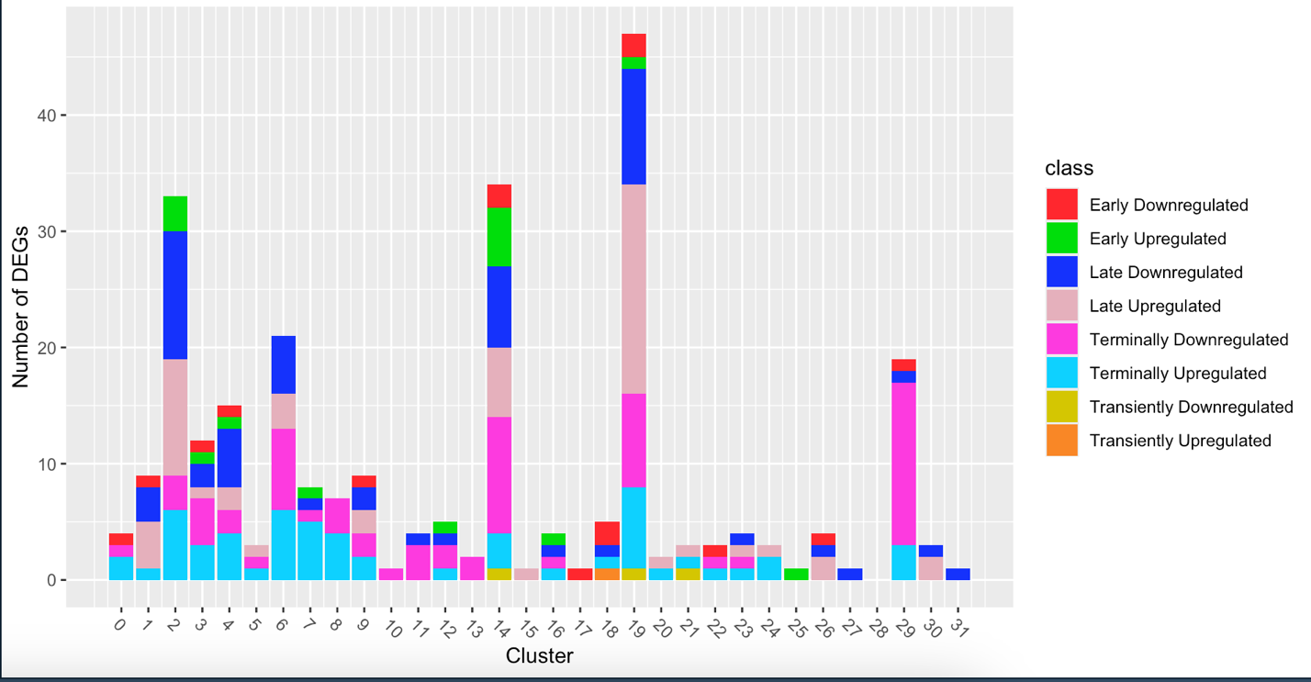
New DEGs
Labeled clusters are enriched for DEGs
The amount of early DEGs in Microglia and Radial Glia make them strong candidates for the first initiating sex change
I also checked for enrichment for DEG class as well as first and second word in DEG class, only 29 was enriched for either
POA
Radial Glia
Microglia
Dm
Fibroblasts
Oligos
Notes:
I define these classes of DEG based on pairwise comparisons between dominants, males, and females, I think they are pretty intuitive

Slide 9
GO Analysis of DEGs
Cluster 19
D-M; G Protein Coupled Receptor pathway
Cluster 2
D-F; Axon guidance, brain development, positive regulation of RNAPII
Cluster 14
D-F; Semaphorin plexin pathway, signaling, regulation of response to external stimulus, axon guidance, cell communication, angiogenesis, nervous system development, cell differentiation

Slide 10
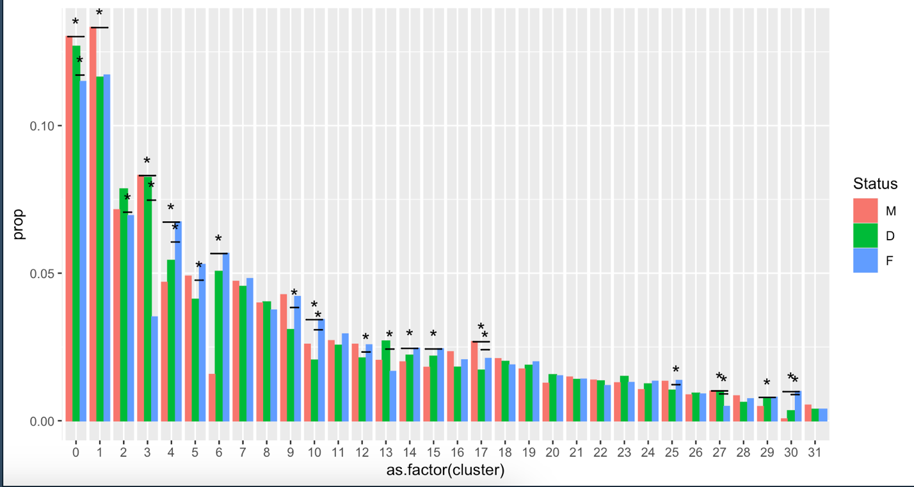
Proportion Differences
POA_1
Clusters with at least 2 pairwise differences:
Downregulated
0 - POA_1 – mixed
3 - gal+ GLUT – probably POA
27 - POA_6_GLUT (potentially PVN)
Upregulated
4 – Oligodendrocytes
30 – Ignore
Transient Changes
10 - ccka+Glut_1
17 - POA_3 GLUT
gal+
Oligs
ccka+
POA_3
POA_6

Slide 11
Proportion Differences
It seems like POA clusters
particularly undergo proportion
changes
Clusters with 1pairwise difference:
Downregulated
1 - POA_2
Upregulated
6 – Dm (?)
14 – Microglia
15 - pdyn+
29 – Fibroblasts
Transient Changes
2 - Radial Glia – Up
5- npy+ cckbra+ - Down
9 – tac1+ - Down
12 – ach+ - Down
13 – Di-G – Up
25 – GABA - Up
POA_2
npy+
cckbra+
ach+
glut
RG
Di-G
cckbra+
POA_3
cckbra+
cckb+
Dm
tac1+
MG
GABA
cckbra+
Fibro

Slide 12
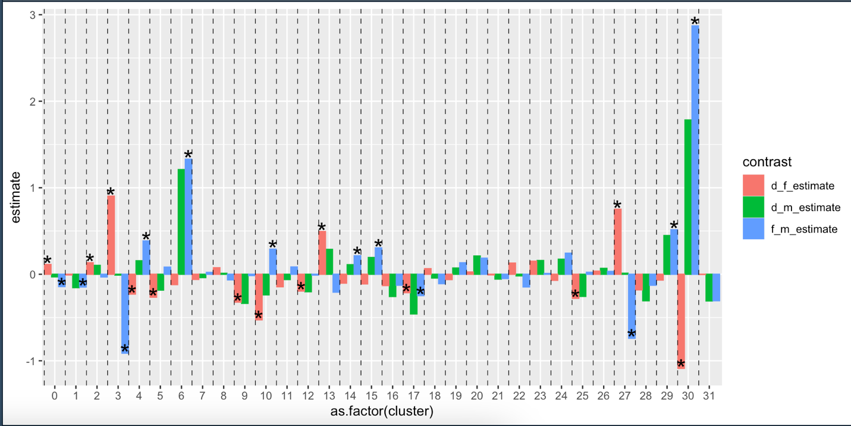
Visualized Another Way
Is a binomial GLM
the right way to do
this? GLMER or fisher?
Binomial glm ~ Sex, pairwise contrasts

Slide 13
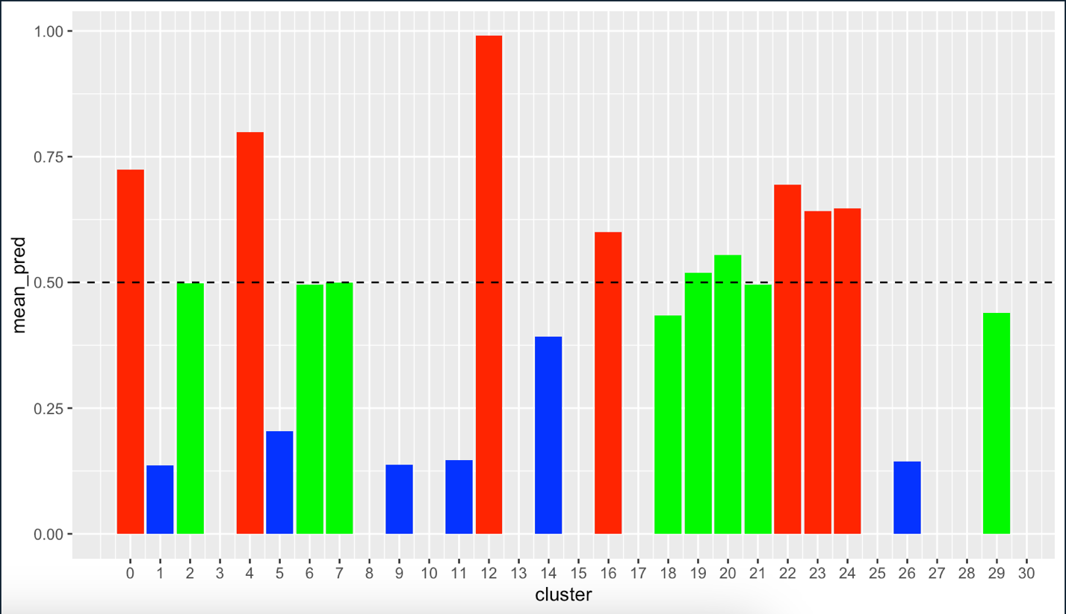
Lasso Penalized Prediction of Sex in Dominants
Here, we summarize the expression of the DEGs from the negative binomial, train a lasso model on the data for males (0) and females (1), and then predict the sex of the dominants
This plot is the mean sex of all of dominants in each cluster, red is female, green is intermediate, and blue is male
Microglia, radial glia, Dm, and fibroblasts and the POA all seem to be in a male – intermediate stage, while oligos have changed
Oligos
Radial
Glia
Dm
POA
Fibro
Microglia
Notes:
While this can tell how male or female a given cluster is, it is constrained to 1 or 0 so we need to combine it with continuity analysis when making any statements

Slide 14
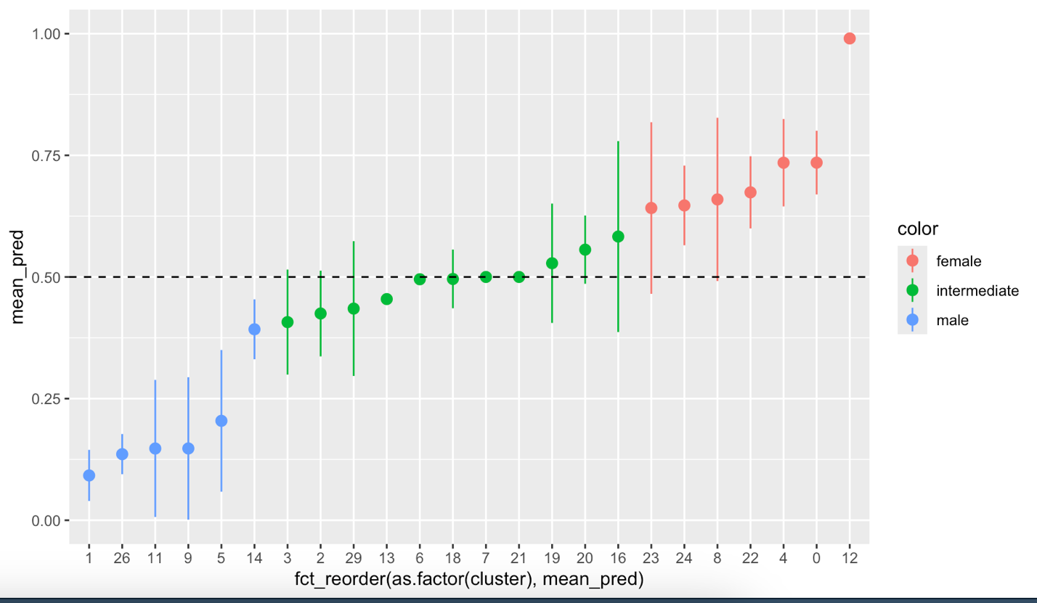
Visualized Another Way
Do we focus more on clusters that have already changed sex, intermediate, or yet to sex change? Which of these makes sense as the orchestrator of sex change?
One caveat here is this is by DEGs, so clusters with few DEGs may be skewed or removed
Yet to Change Sex
Sex Changing
Completed Sex Change
Ach+
Glut1
cckb+
GLUT
Olig
GLUT
GLUT
POA-4
Mixed
tac1+ GLUT
POA-1 GABA
RG
Dm
Epen
MG
Ach+
GLUT2
GABA
npy+
POA-5
GLUT
tac1+ GLUT2
Di-G
GLUT
OPC
gal+ GLUT
Fibro
Leuko
POA-2
GABA
ccka+
GLUT
cckbra+
GABA
Notes:
Do we focus more on clusters that have already changed sex, intermediate, or yet to sex change? Which of these makes sense as the orchestrator of sex change?

Slide 15
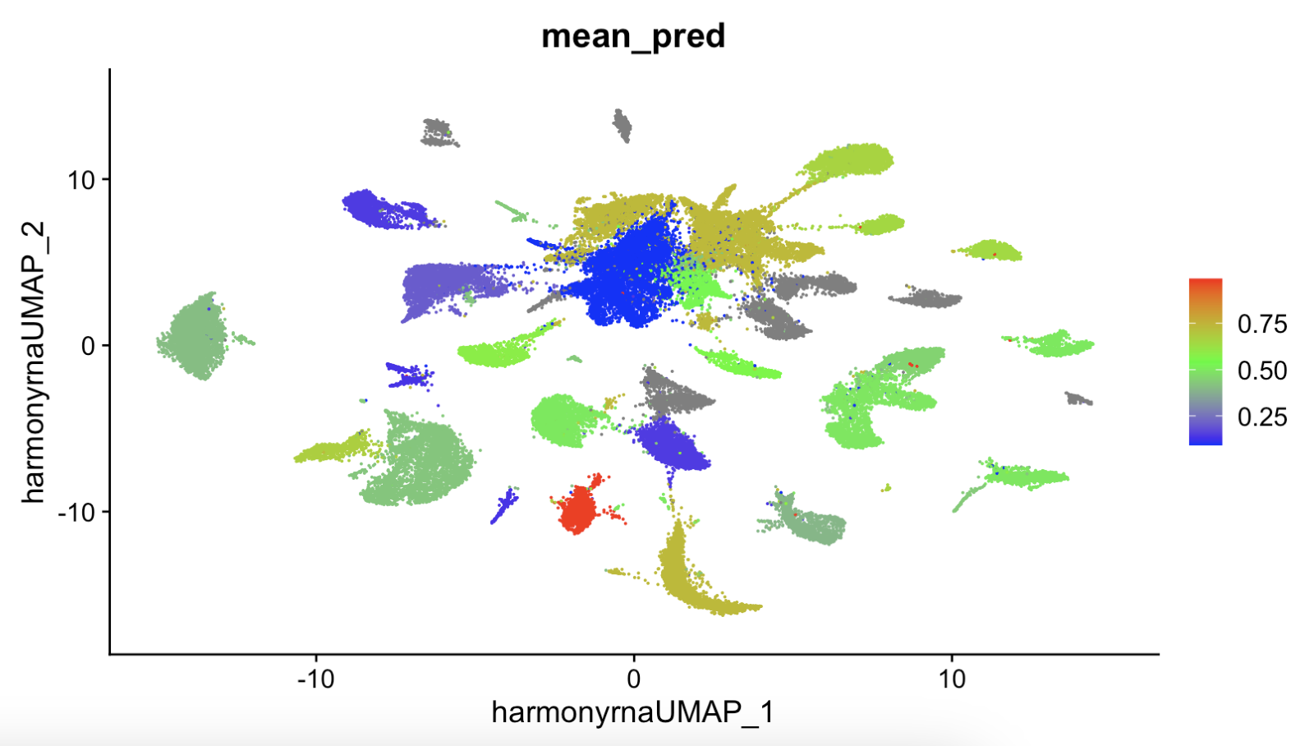
And Another Way
19
29
6
2
14
4

Slide 16
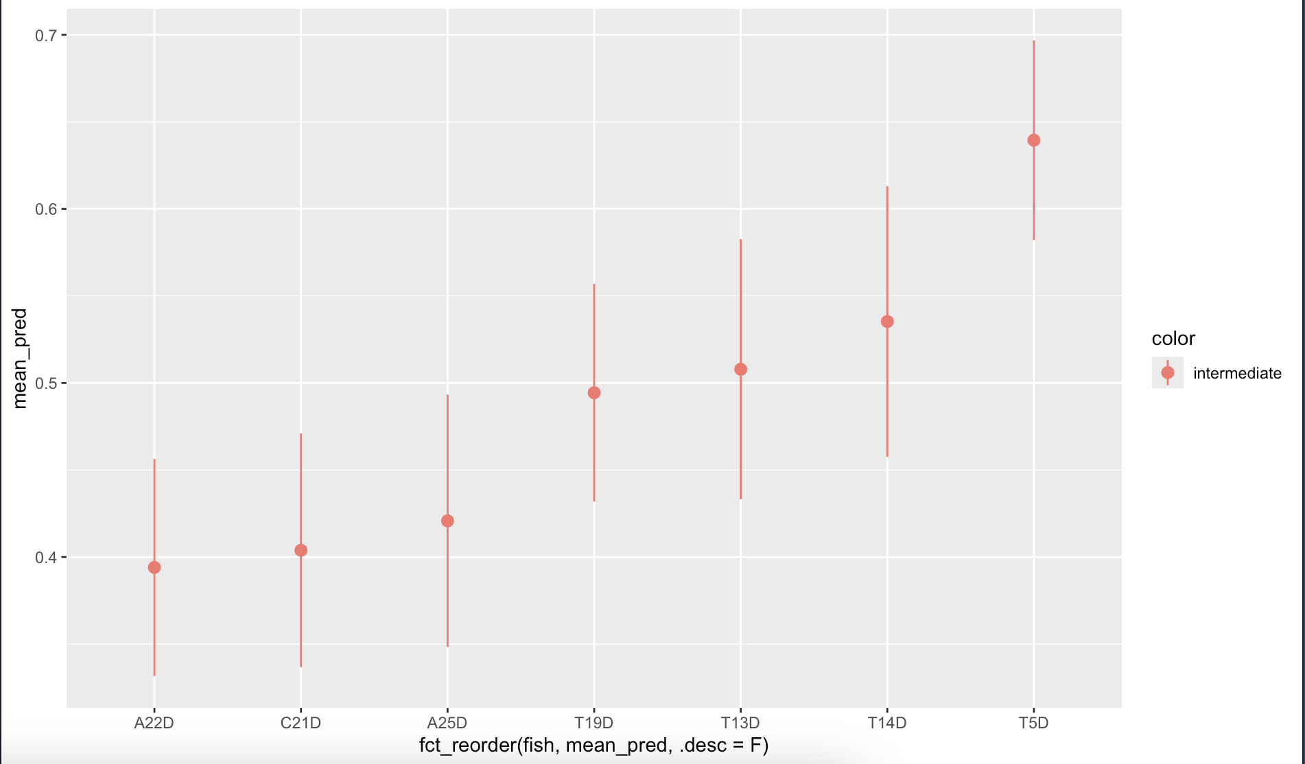
What is the Mean Lasso Prediction Across Clusters
The mean lasso score across all clusters +/- SE
All fish fall into an intermediate category if we consider male to be <0.33 and female to be >0.66
This aligns more strongly with physiology data (11KT and gonads) than behavior data (not shown)
Notes:
All individuals fall in the intermediate category which is exactly what we wanted

Slide 17
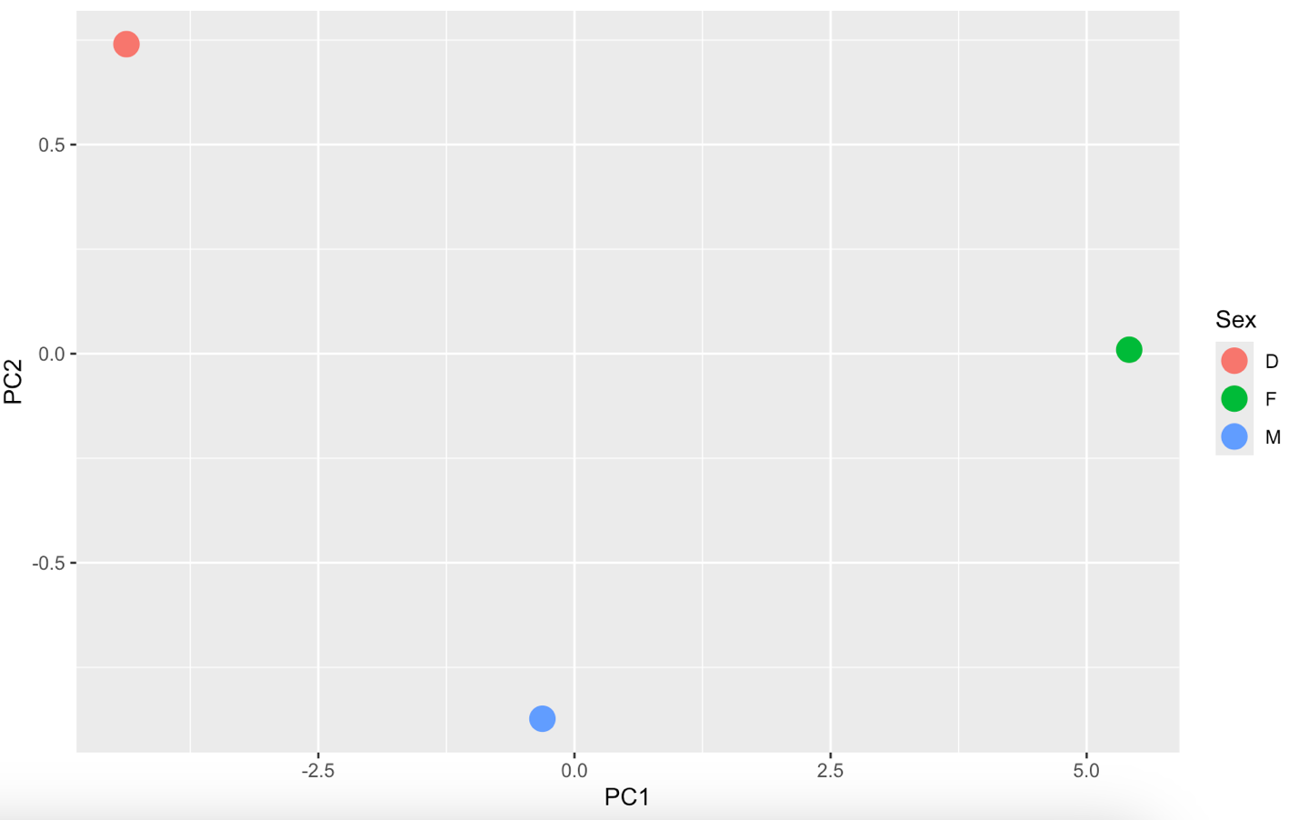
Is Sex Change Linear? – Continuity Analysis
Here, we subset to DEGs from the negative binomial and use PCA to summarize gene expression
We then ask, do dominants lie along a line between males and females, or do they become different from both during sex change?
(Euclidean distance between M-F)/(Euclidean distance M-D + F-D)
As this approaches 0 , sex change is less linear, as it approaches one, sex change is more linear

Slide 18
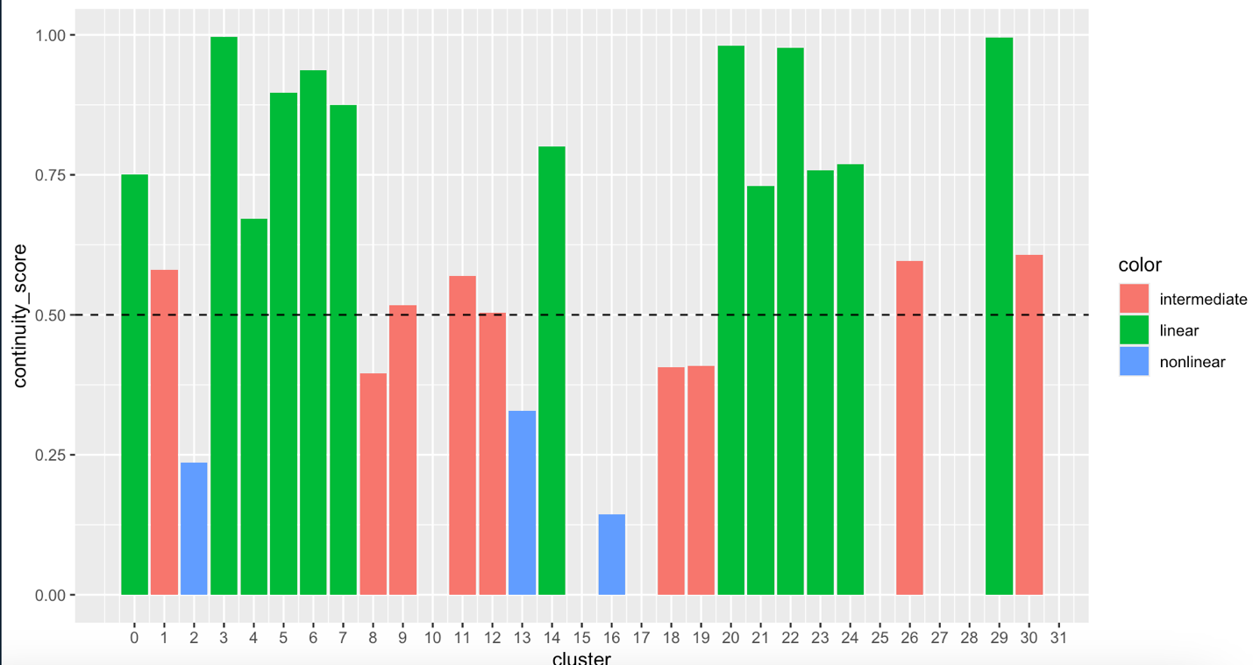
Continuity Analysis
One caveat here is this is by DEGs, so clusters with few DEGs may be skewed or removed
Fibro
Dm
MG
Oligos
POA-2
GABA
ccka+
GLUT2
POA-6
Leuko
Ach+
GLUT1
cckb+
GLUT1
POA-4
RG
GLUT
tac1+
GLUT
Di-G
GLUT
OPC
Notes:
POA4 and RG get weird (as well as a few others), while microglia, oligos, fibros, and Dm stay normal

Slide 19
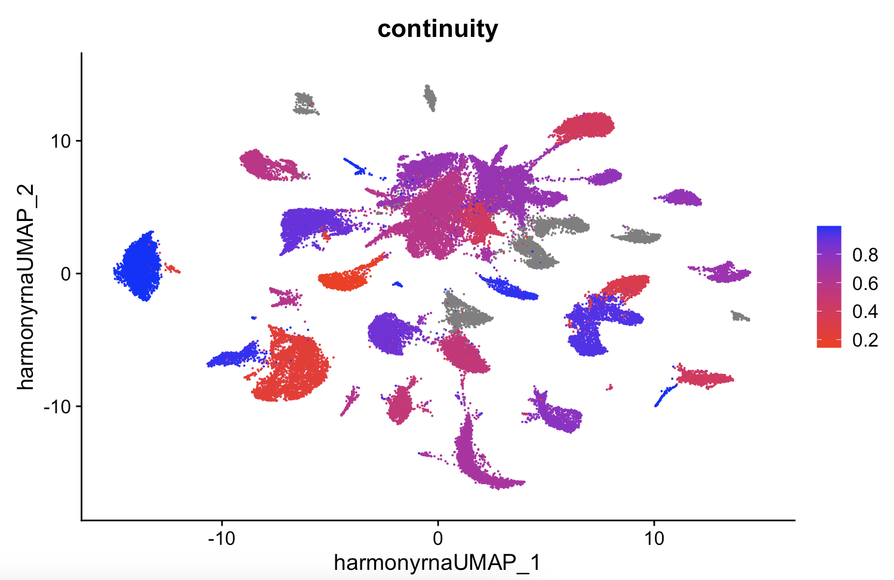
Visualized Another Way
19
29
6
2
14
4

Slide 20
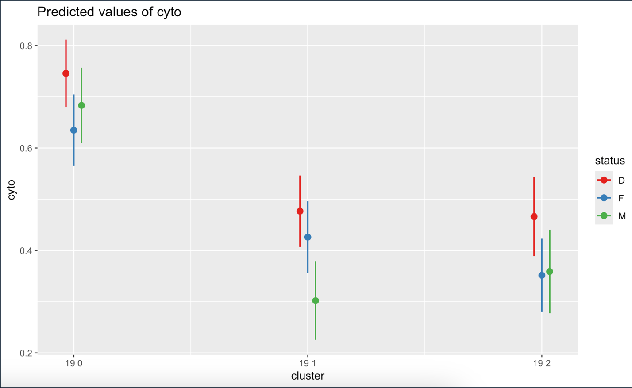
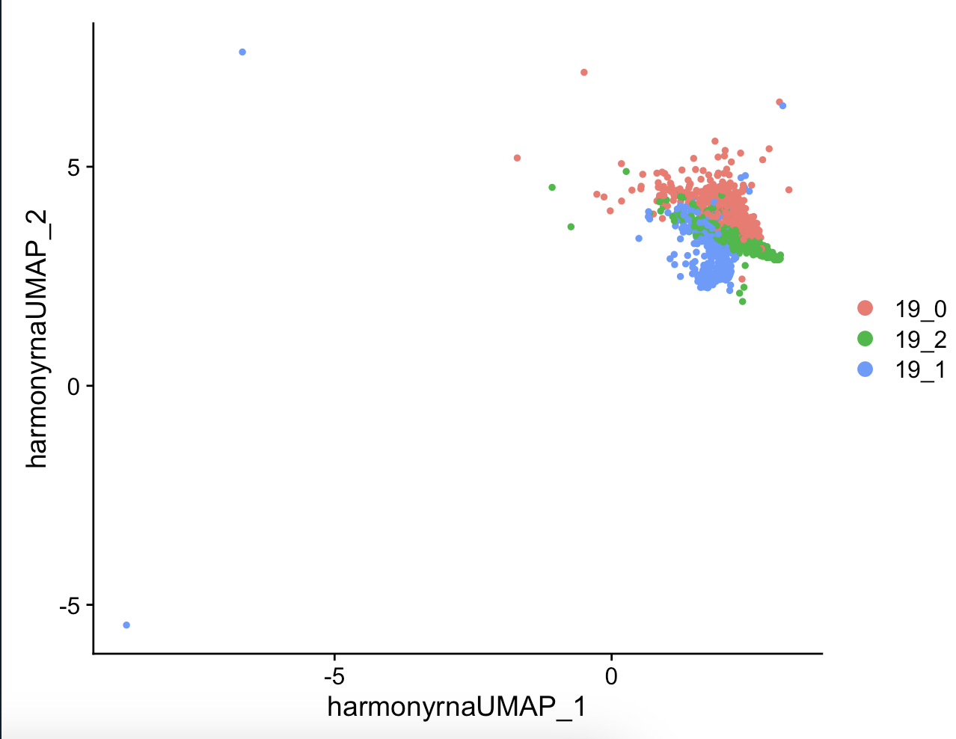
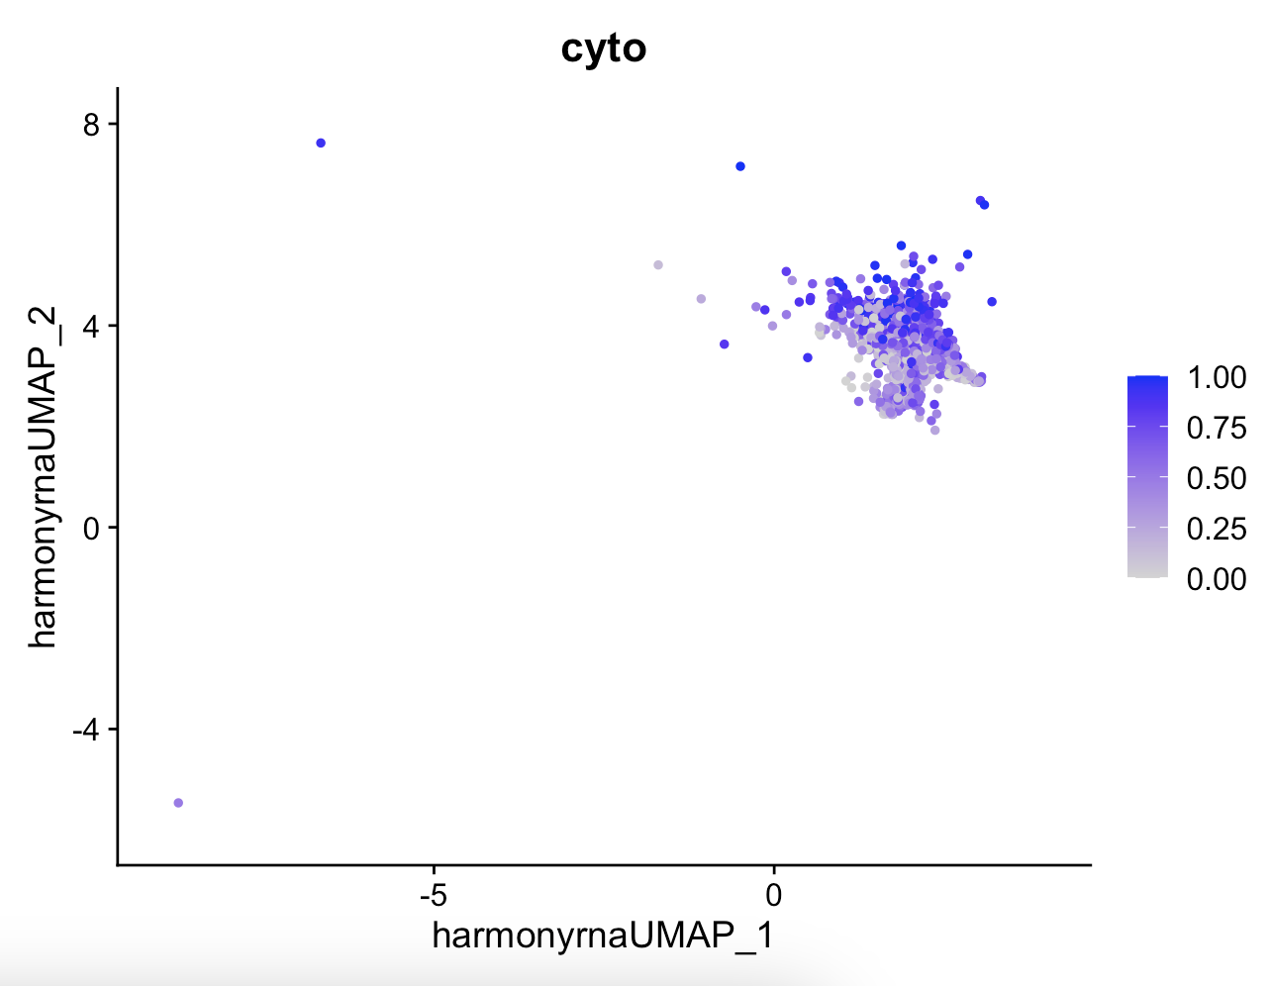
A Deep Dive Into POA_4 – Cluster 19 - CytoTRACE
lmer(cyto~cluster *status+ (1|individual))
*
*
*
*
3 Subclusters (we want to use Lynnas Method in the future)
The subclusters differ by cytotrace score.
Dominants significantly less differentiated than females in 0.
Males significantly more differentiated than both in 1.
Dominants significantly less differentiated than bothin 2.
Notes:
Add UMAP with all clusters labeled, see if 19 is positive for estrogen and androgen receptors

Slide 21
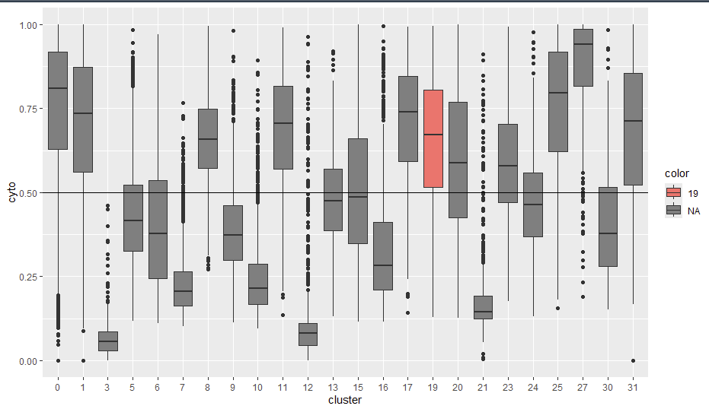
Is Cluster 19 Particularly Mature or Immature?
I was curious if cluster 19 is more or less differentiated than the average neuronal cluster, so I ran CytoTRACE on all the neuronal clusters
Cluster 19 is significantly less differentiated than the average (0.5)
Notes:
I’m not sure how robust this method is

Slide 22
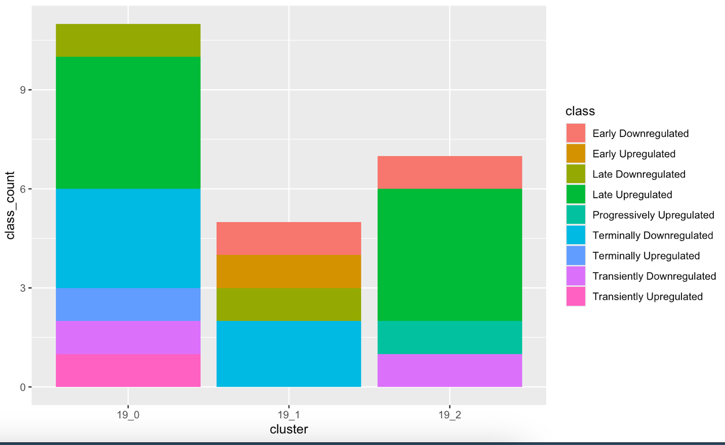
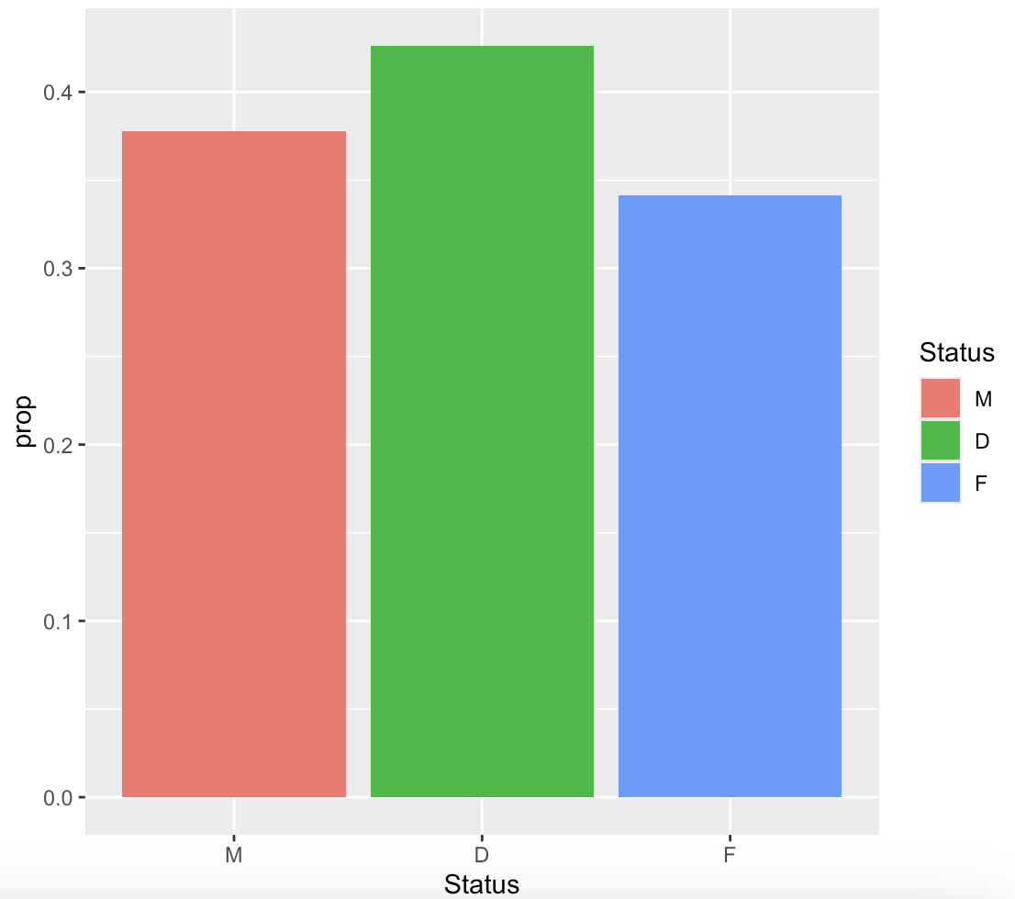
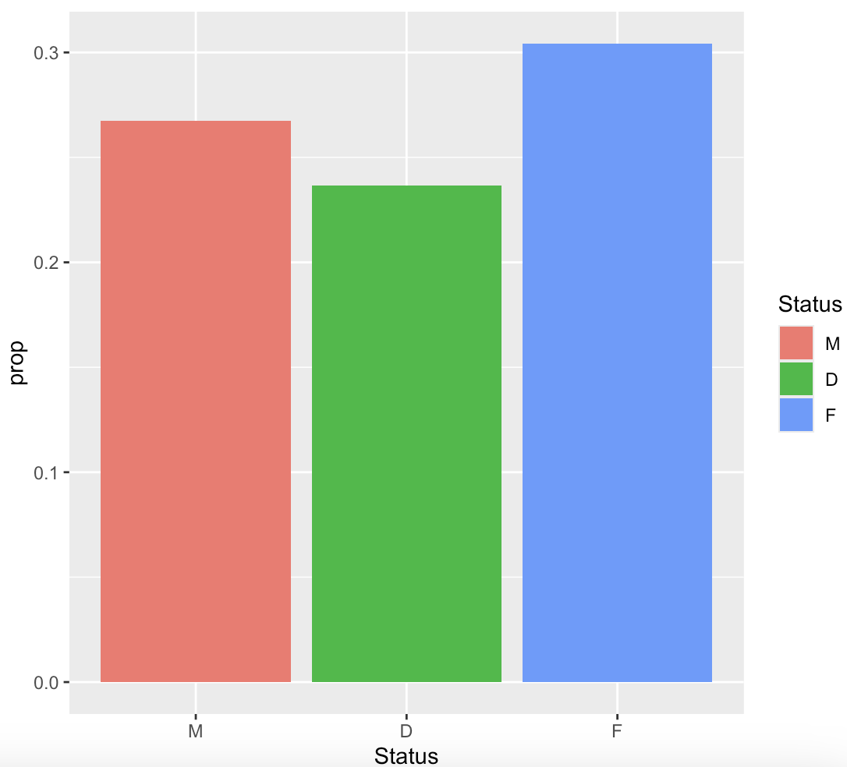
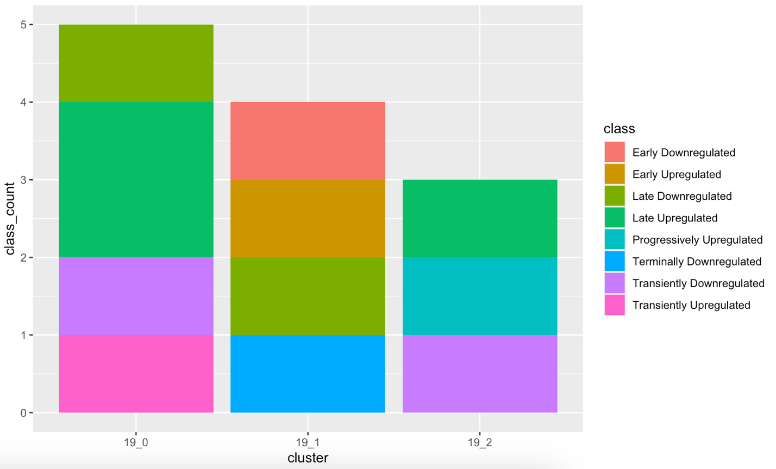
A Deep Dive Into POA_4 Contd. – DEGs and Prop
*
Negative binomial model shows 19_0 and 19_2 have more DEGs, but 19_1 has more early DEGs.
Dominants have significantly higher proportion of cells in 19_0 compared to females
No Significant difference in 19_2 though it sure looks like it
Excluding Singular DEGs

Slide 23
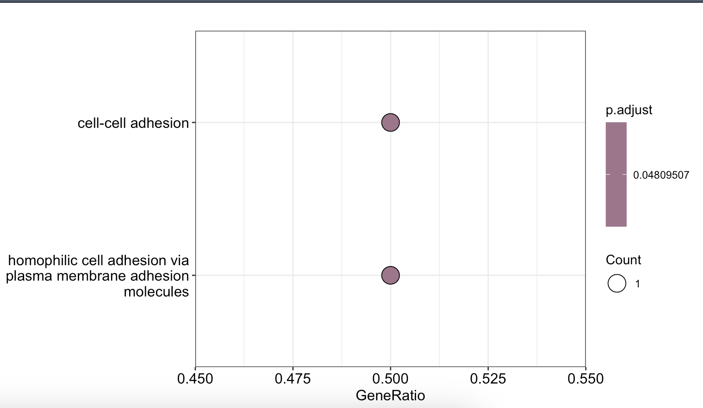
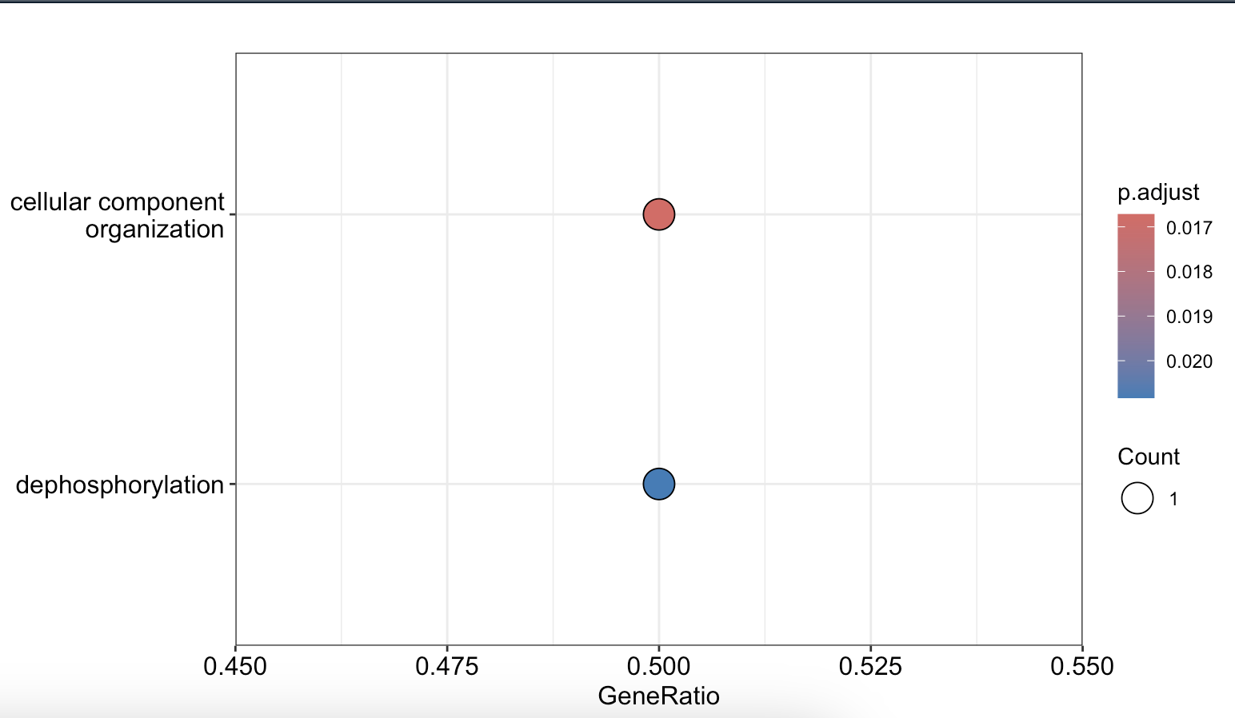
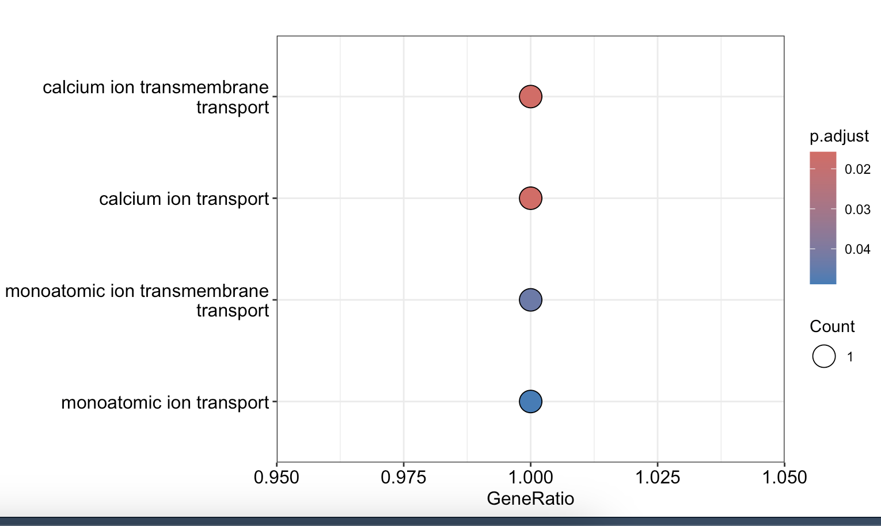
A Deep Dive Into POA_4 Contd. – DEGs GO
19_1 Terminally Downregulated
19_2 Late Upregulated
19_0 Late Upregulated

Slide 24
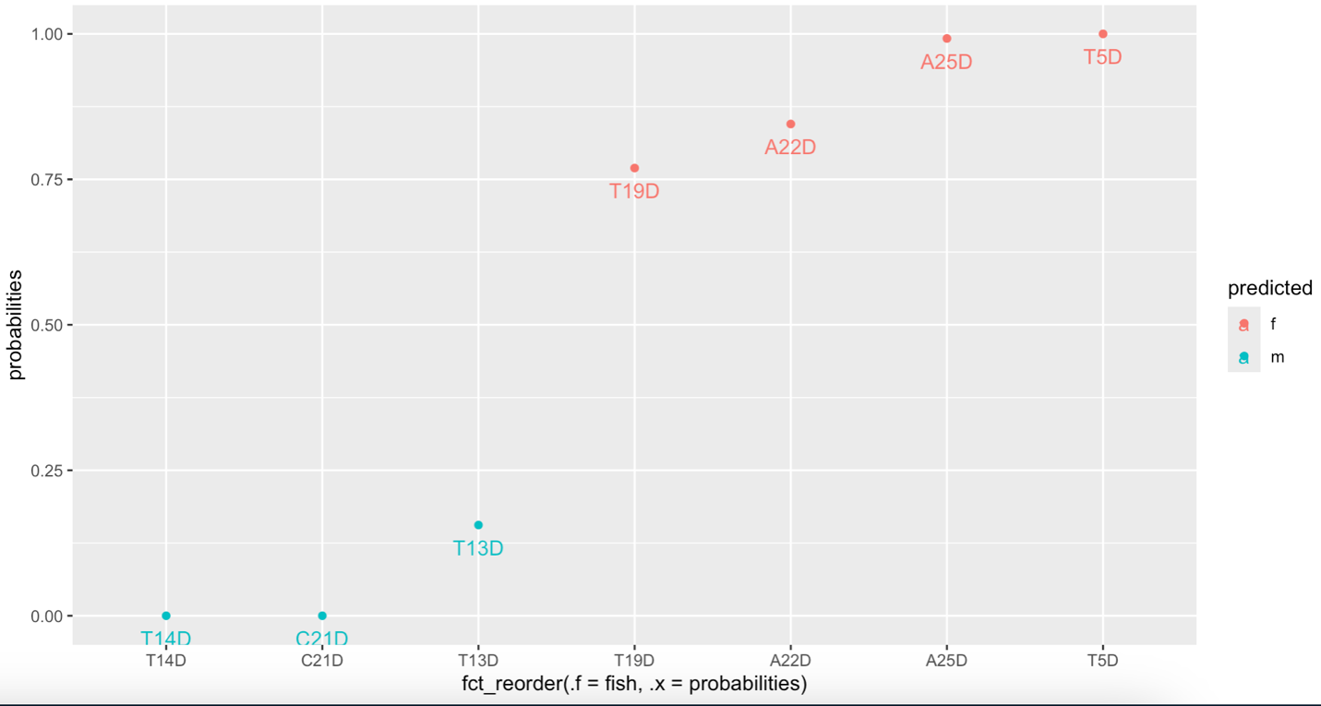
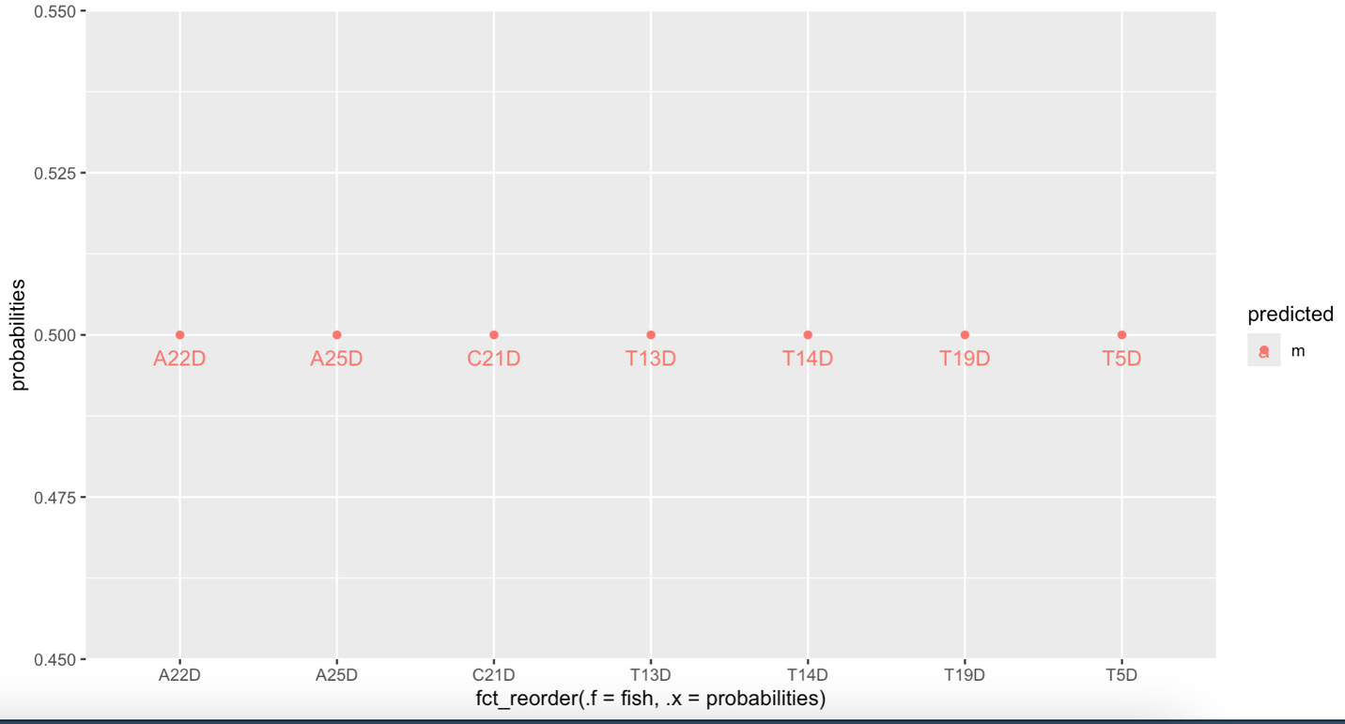
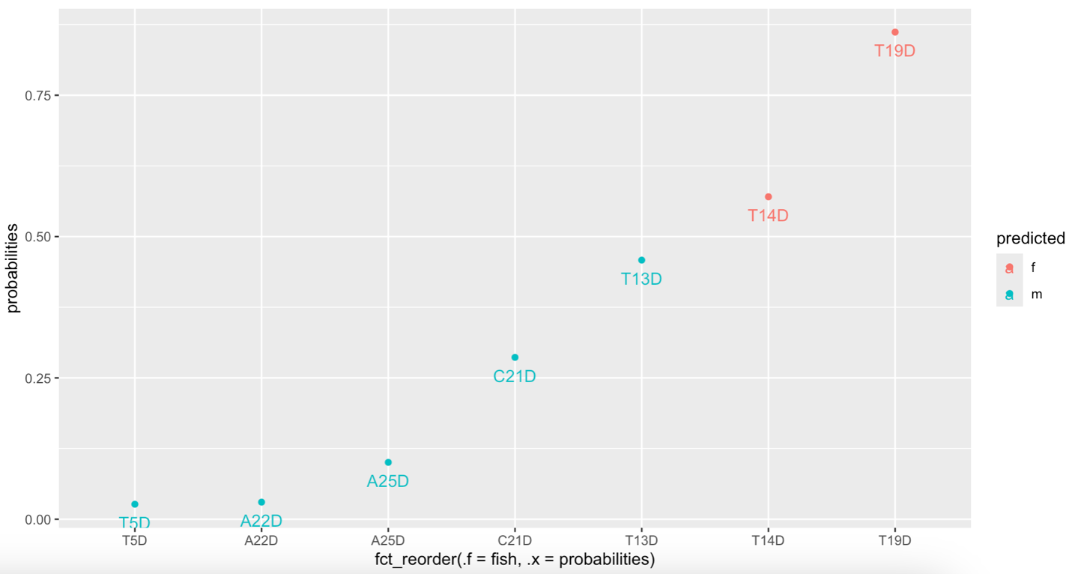
A Deep Dive Into POA_4 Contd. - Lasso
19_0
19_1
19_2
Lasso regression Scores for all of the dominants in the subclusters. 19_0 is more feminine on average (0.54) while 19_2 is more masculine (0.33), I have no idea why all of the scores for 19_1 is 0.5.
More analyses?

Slide 25
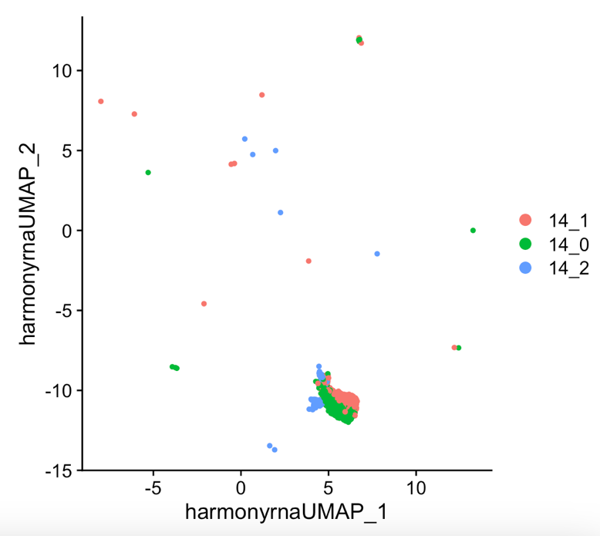
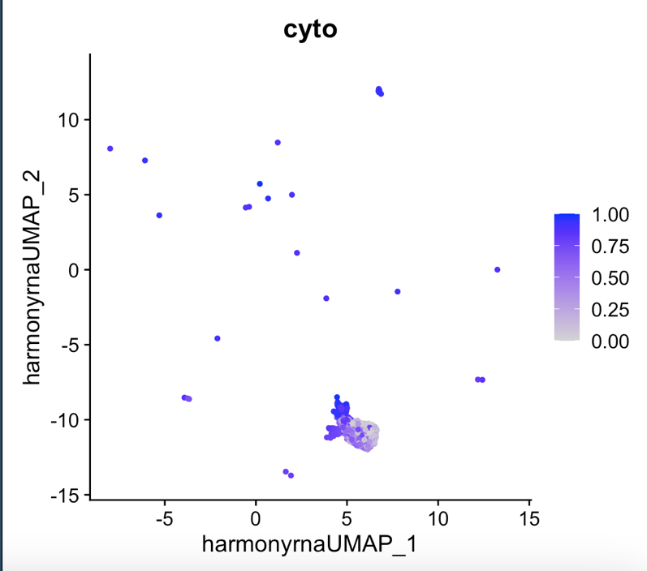
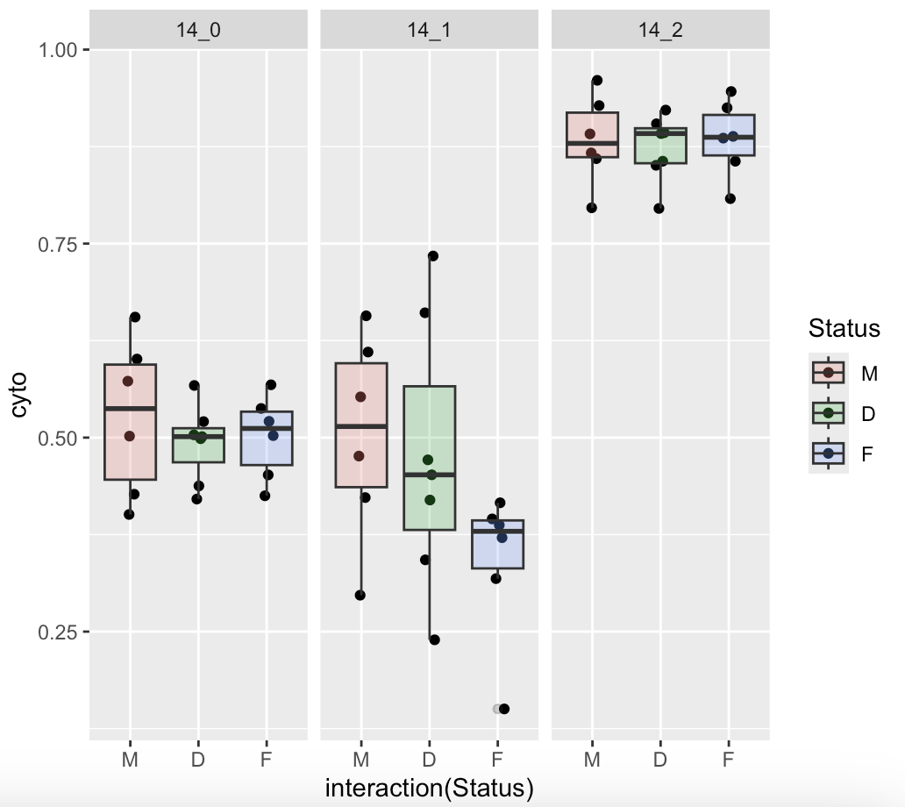
A Deep Dive Into Microglia – Cluster 14 - CytoTRACE
The 3 subpopulations differ by cytotrace score with 14_0 being intermediate, cluster 14_1 being interesting (does not significantly differ by sex but look at it), and cluster 14_2 being undifferentiated. All clusters significantly differ by cytotrace score
Again, 3 subclusters

Slide 26
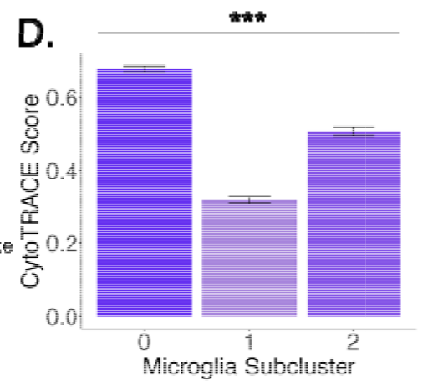
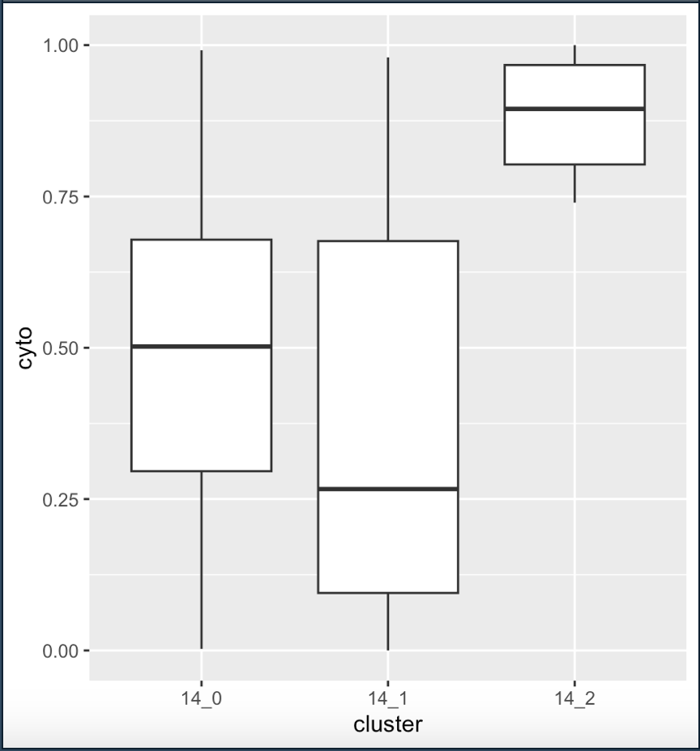
A Deep Dive Into Microglia Contd. - CytoTRACE
My clusters align with Meghan’s subclusters which I think is interesting

Slide 27
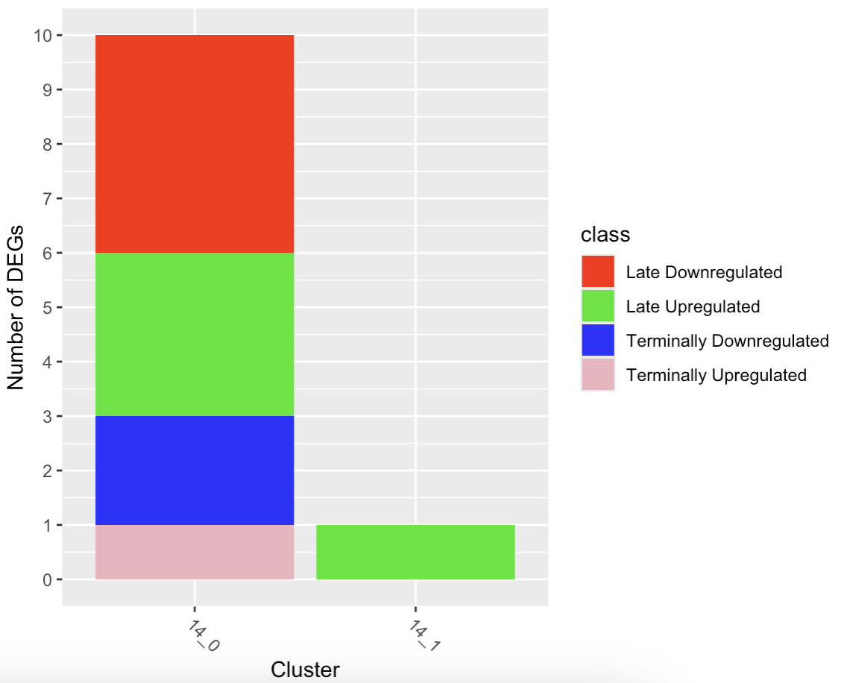
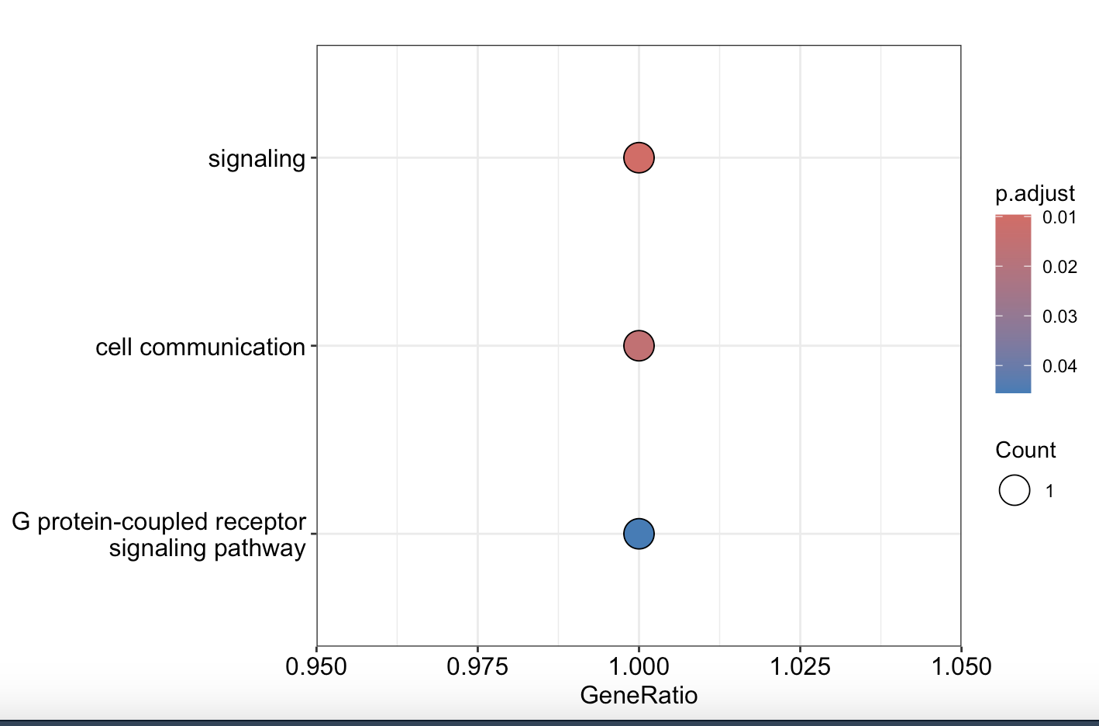
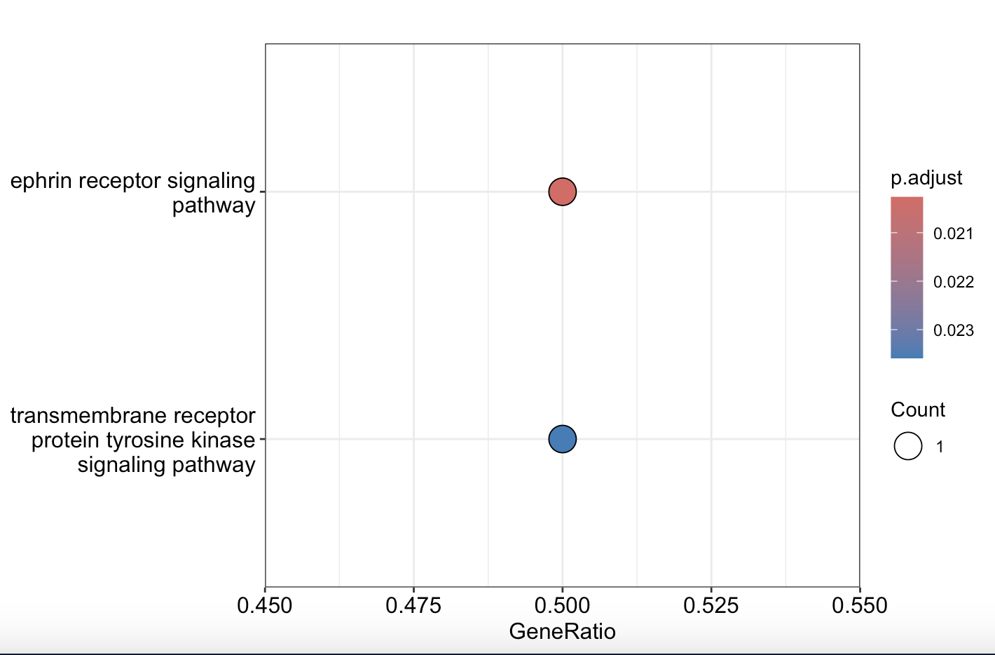
A Deep Dive Into Microglia Contd. – DEGs and GO
GO - 14_0, late downregulated
GO - 14_0, terminally downregulated
Negative binomial, 14_2 had no DEGs, 14_0 is the interesting one
The ephrin receptor that is downregulated in 14_0 is epha7, a repulsive eph
slco2b1 - solute carrier organic anion transporter family member 2B1 was terminally upregulated
Takes up sulfated steroids
Glutamate receptor is also downregulated

Slide 28
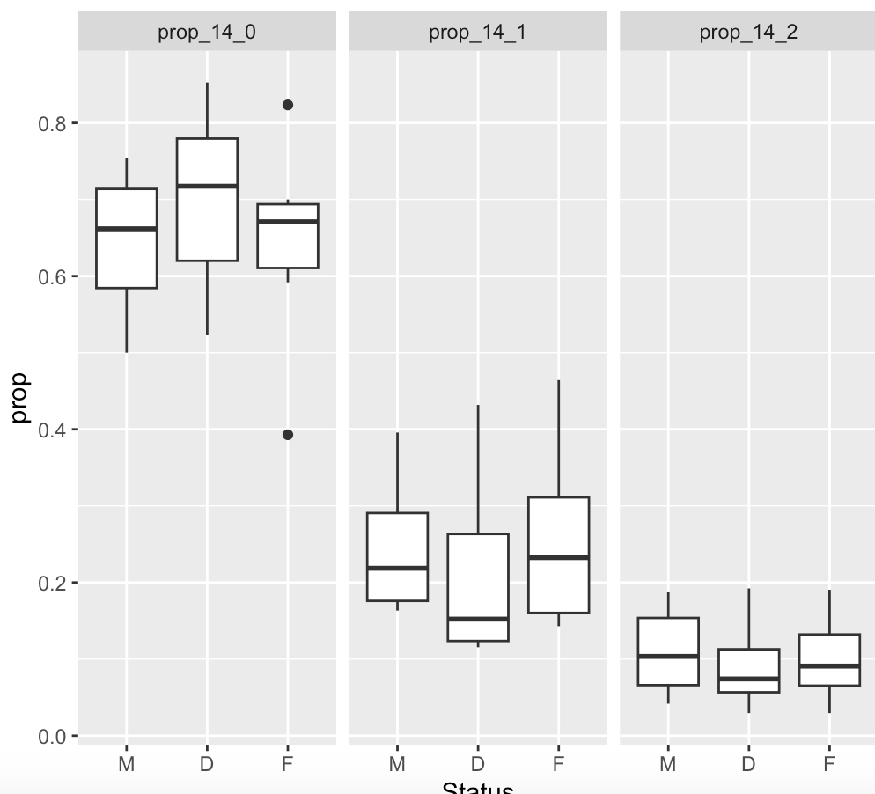
A Deep Dive Into Microglia Contd. - Prop
I found no significant sex differences in terms of proportion membership. My analysis hit a wall here

Slide 29
Open Questions
Would a cluster that orchestrates sex change be in the midst of sex change, or have completed sex change? (see lasso prediction)
Spatial mapping of clusters?
scGESTALT markers (I did some initial but I’m not super confident in my mapping)
That paper gives a list of marker genes, is there some Seurat function to determine which cluster best aligns with that or something similar
Cichlid markers
HypoMAP (again, not very confident in my mapping)
How to analyze proportion differences?
Fisher test?, Binomial GLM? Binomial GLMER?
I used Binomial GLM here
Which clusters to exclude (see next slide)

Slide 30
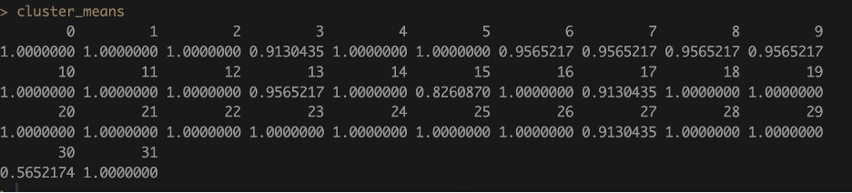
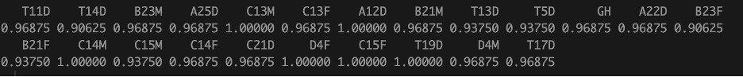
Which Clusters to Exclude?
Proportion of fish with nuclei in a given cluster. Cluster 30 – OB, 15 – Uncclear.
What about others
By individual, maybe we remove clusters we know are bad first and then review if there are any bad fish?

Slide 31
Next Analyses
Gabe
Radial Glia, Dm, Fibroblast, Oligodendrocyte deep dive
Are CCKs and CCKRs DEGs?
Proportion DEGs
Behavior, Gonad, 11KT DEGs
Trajectory / pseudotime analysis from radial glia
Zack
Spatial mapping
Ideas?
NeuronChat? Other tools?

